Slide 1
YS375F – Continuous Wavelength Module
Kim Feijen
Opto-mechanical architect

Slide 2
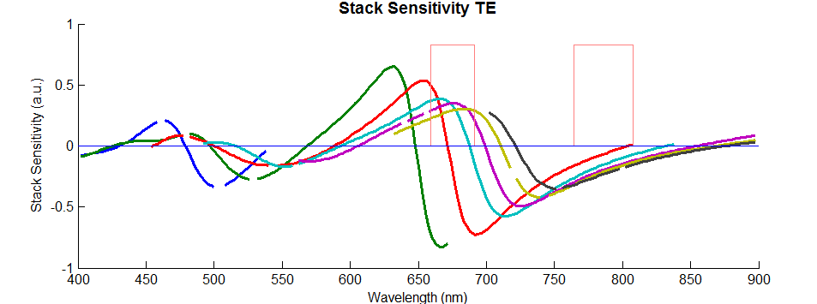
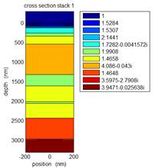
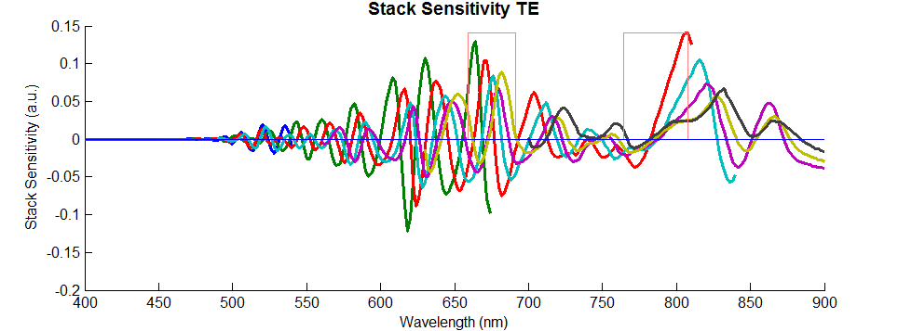
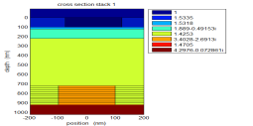
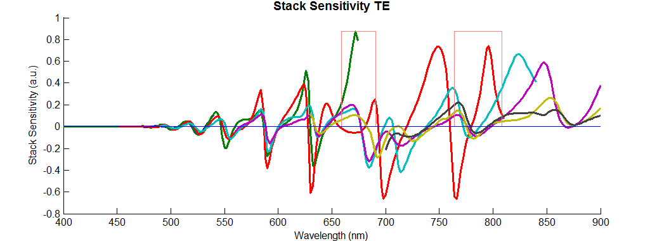
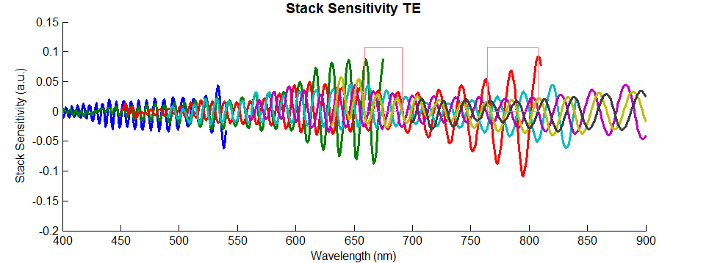
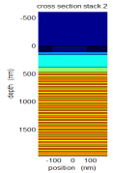
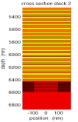
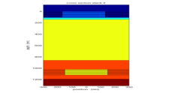
Thick stacks make robust recipe determination difficult
Known memory user cases (eF2X / D2H):
Increasing stack thickness increases the swing curve behaviour however the stack complexity can also have an influence on “thin” stacks.
Recipes using “peak” wavelengths are least sensitive to process variation
3 µm DRAM (D5)
Peak-peak: 20 nm → fine WL adjustment required
0.9 µm DRAM (C6)
Stack sensitivity
1.1 µm DRAM (A1)
6.5 µm 3D NAND (NONO, 96 tiers)
Sensing wavelength
Slide MMBM
Notes:
Why do we need CL? Our application friends did some measurements with a MC 250 LPPS and next to that simulations. In the results they see that the stack sensitivity is a swing curve which correlates with a wavelength. This swing curve behavior is increasing when the stacks become thicker like we can see on the right picture.

Slide 3
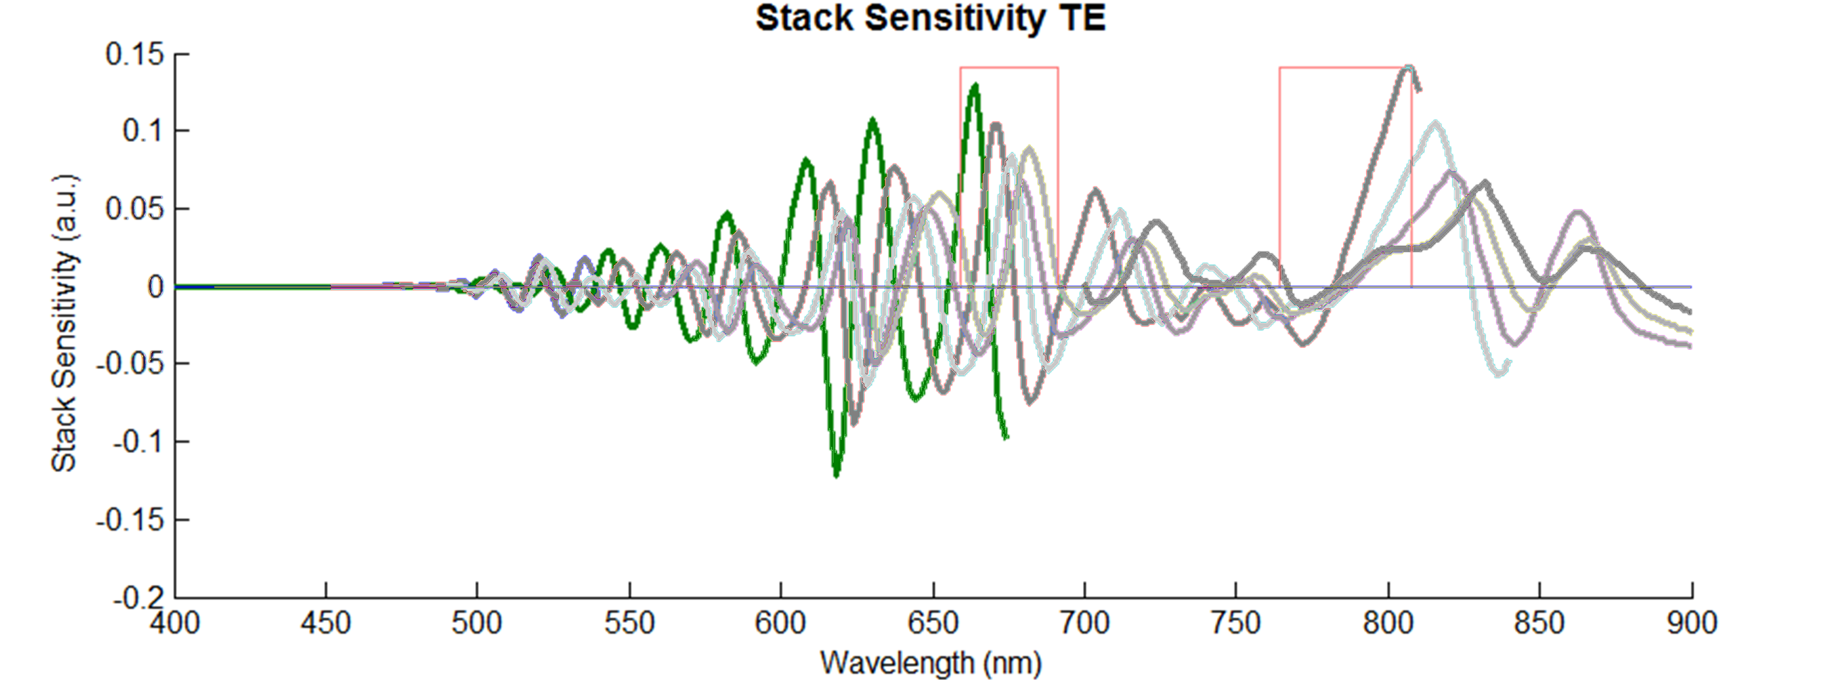
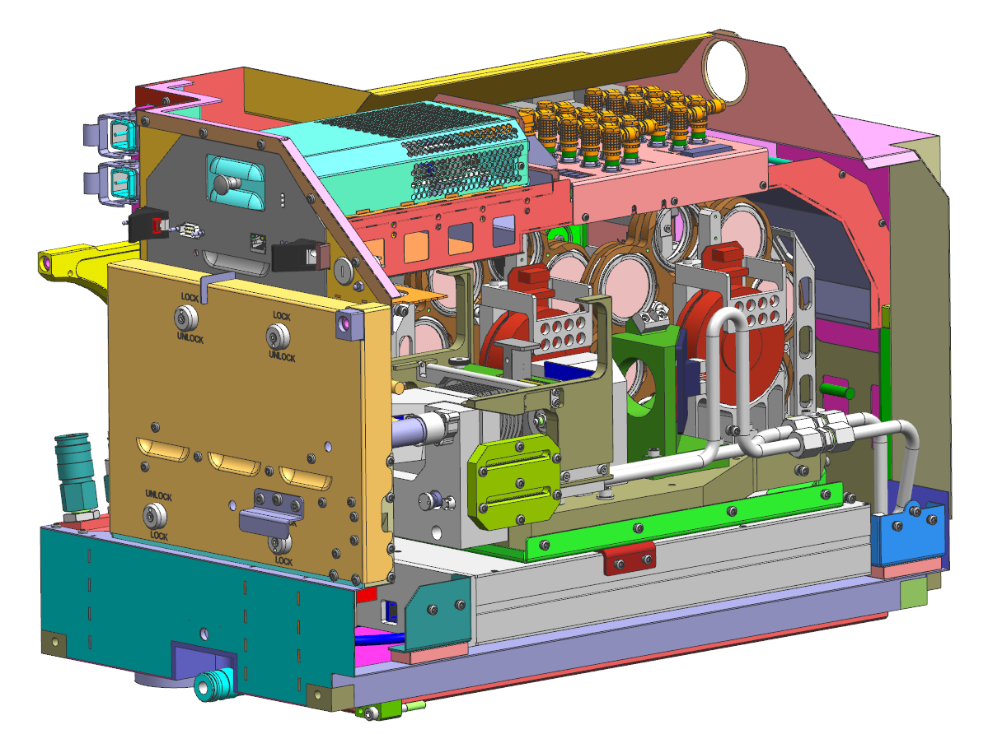
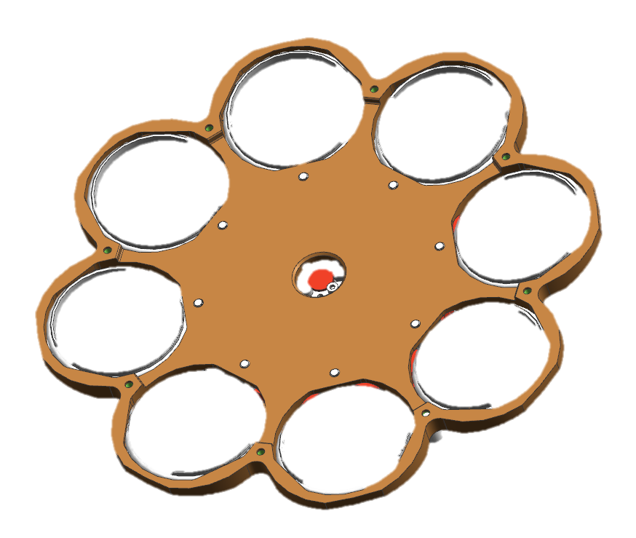
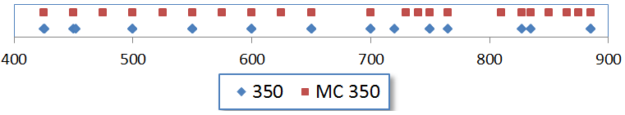
Current situation to near future
LPPS YS350 → MC LPPS
4x
Notes:
If we look to the current situation, then we see that the stack sensitivity for instance on [click] 600nm is zero. This means we have a very bad stack response resulting in difficult to measure markers. [click] At approx. 620nm we see the highest stack sensitivity. For the customer it would be nice if he can select a wavelength which is close to this peak. [click] With the MC LPPS we can give the customer some additional wavelengths already, as we swap the WB filters for new NB filters in the LPPS.

Slide 4

Tunable wavelength selector
Tunable wavelength to improve stack sensitivity
Notes:
Going one step further would be giving the customer all desired wavelengths and band widths between 425 and 900nm. This can be done by making use of linear gradient filters, such are some being supplied by Delta Thin film. [click]

Slide 5


Tunable wavelength selector
Tunable wavelength to improve stack sensitivity
Linear gradient filters
https://www.youtube.com/watch?feature=player_detailpage&v=BcXJoIOtVKQ#t=12
Physics behind thin film interference
https://youtu.be/xjMjWtntm9k?t=348
Notes:
The basic principle is explained in a movie [MOVIE]
The physics principle behind interference filters is explained in the other movie. [MOVIE]

Slide 6
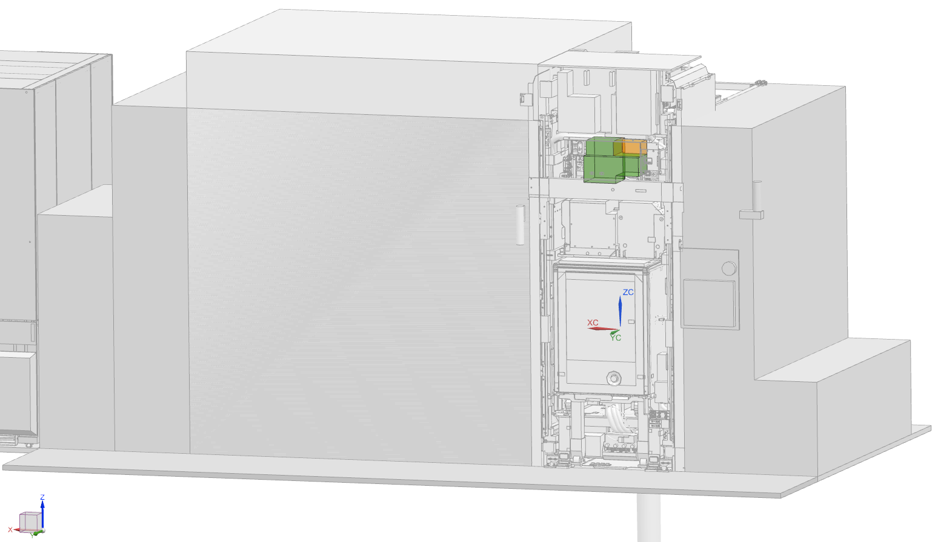
Design constraints
Commercially available linear variable filters
Restricted volume and mass available in the YS
Fast switching required (< 45ms)
One spare slot in YMCR available
Limited power available
No cooling water available

Slide 7
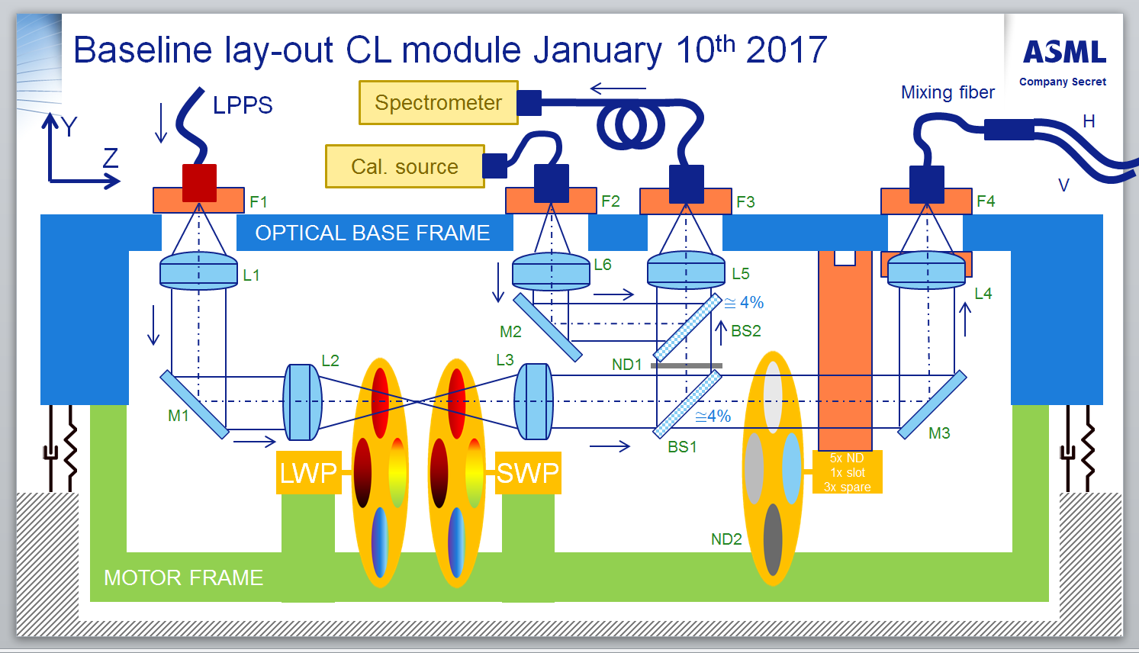
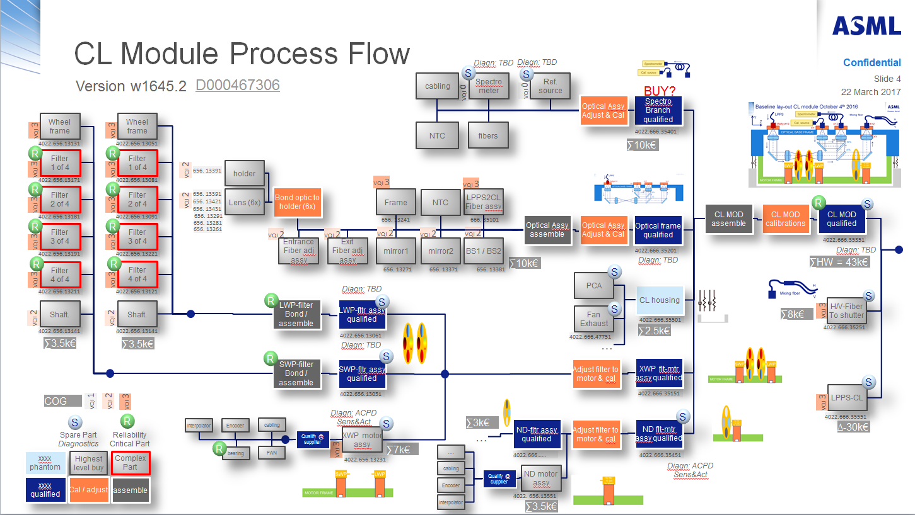
Functional breakdown
Modular approach with a balance between functions and manufacturability
Functions broken down in modular design
Modular design balanced on serviceability and manufacturability with process flow

Slide 8



Baseline lay-out CL module January 10th 2017
LPPS
Spectrometer
Mixing fiber
Y
H
Z
Cal. source
V
F1
F2
F3
F4
OPTICAL BASE FRAME
L1
L6
L5
≅ 4%
L4
M2
BS2
L2
L3
ND1
5x ND
1x slot
3x spare
M1
≅4%
M3
BS1
LWP
SWP
ND2
MOTOR FRAME

Slide 9
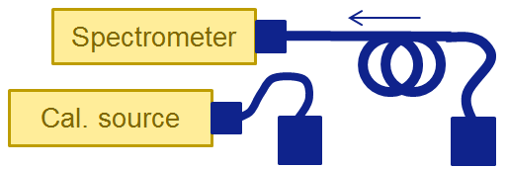
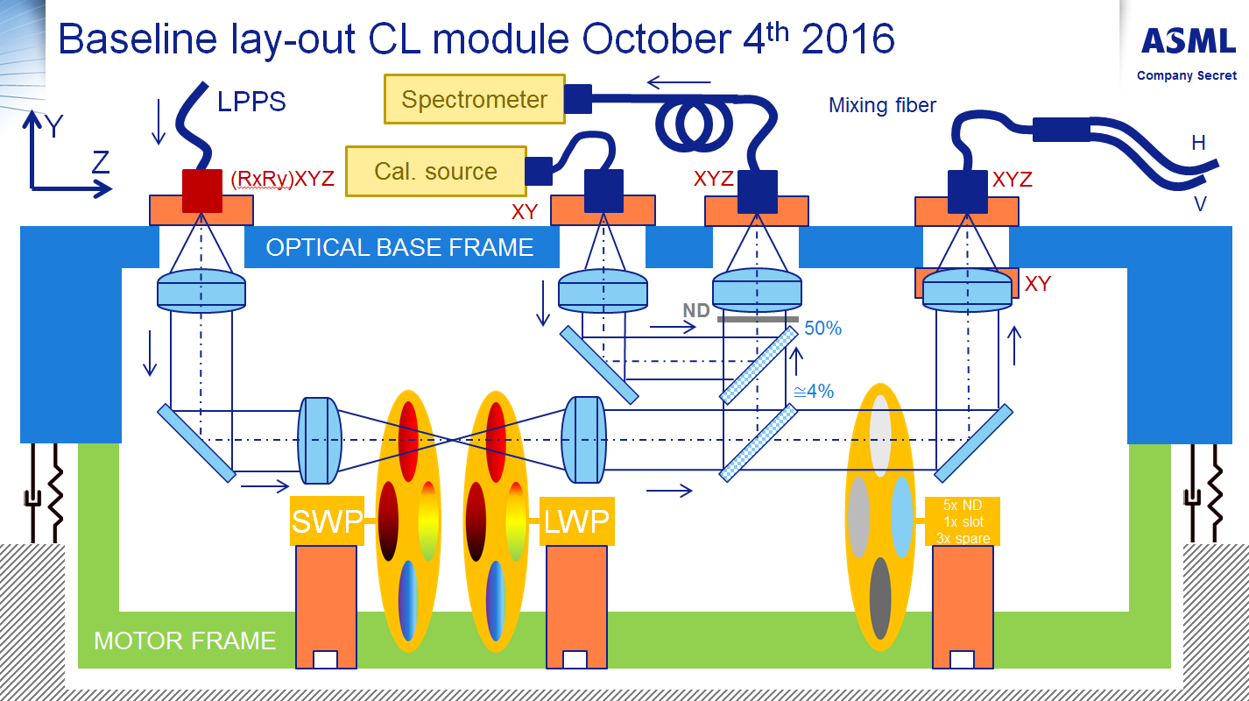
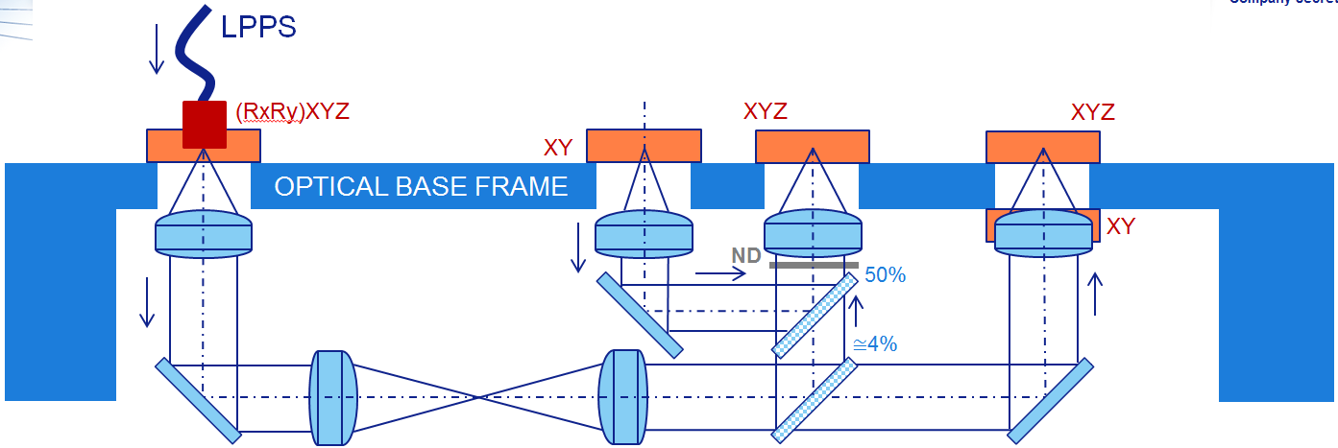

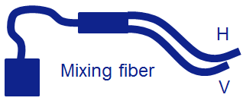
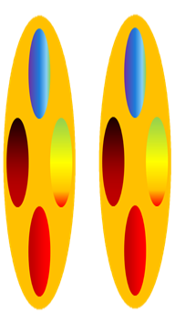

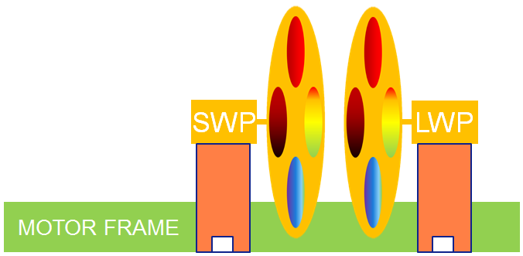

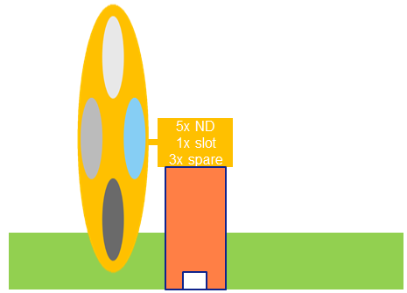
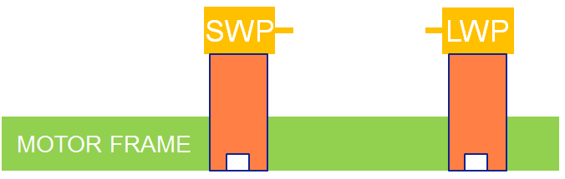

CL Module Process Flow
Diagn: TBD
Diagn: TBD
D000467306
cabling
S
Spectro meter
S
Ref.
source
Version w1645.2
VQI 0
VQI 0
BUY?
Optical Assy
Adjust & Cal
Spectro Branch
qualified
Wheel frame
Wheel frame
NTC
fibers
VQI 3
VQI 3
4022.666.35401
R
4022.656.13131
R
4022.656.13051
∑10k€
Filter
1 of 4
Filter
1 of 4
VQI 3
VQI 3
VQI 2
656. 13391
holder
R
4022.656.13171
R
4022.656.13081
VQI 3
VQI 3
Filter
2 of 4
Filter
2 of 4
VQI 2
656. 13391
Lens (6x)
Bond optic to holder (6x)
Frame
NTC
LPPS2CL
Fiber assy
R
VQI 3
VQI 3
656. 13421
CL MOD
assemble
CL MOD
calibrations
CL MOD
qualified
S
656. 13431
4022.656.13181
4022.656.13091
656. 13291
656. 13241
666. 35101
Optical Assy
assemble
Optical Assy
Adjust & Cal
Optical frame
qualified
R
Filter
3 of 4
R
Filter
3 of 4
656. 13281
656. 13261
VQI 2
VQI 2
VQI 2
VQI 2
VQI 2
VQI 3
VQI 3
Entrance
Fiber adj assy
Exit
Fiber adj
assy
mirror1
mirror2
BS1 / BS2
4022.666.35351
4022.656.13191
4022.656.13221
4022.666.35201
Diagn: TBD
R
Filter
4 of 4
R
Filter
4 of 4
656. 13271
656. 13371
656. 13381
∑10k€
S
Diagn: TBD
∑HW = 43k€
VQI 3
VQI 3
PCA
4022.656.13211
4022.656.13121
R
Diagn: TBD
CL housing
S
LWP-filter
Bond / assemble
S
H/V-Fiber
To shutter
Shaft.
Shaft.
LWP-fltr assy
qualified
S
VQI 2
VQI 2
…
Fan Exhaust
∑8k€
VQI 3
4022.666.35501
4022.666.35251
4022.656.13141
4022.656.13141
4022.656.13061
4022.666.47751
∑2.5k€
∑3.5k€
∑3.5k€
Diagn: TBD
…
R
SWP-filter
Bond / assemble
SWP-fltr assy
qualified
S
Adjust filter to motor & cal
XWP flt-mtr
assy qualified
LPPS-CL
S
COG
VQI 1
VQI 2
VQI 3
4022.656.13051
4022.666.35151
VQI 3
S
R
Diagn: ACPD Sens&Act
S
∑3k€
S
4022.666.35551
Interpolator
Encoder
cabling
XWP motor
assy
ND-fltr assy
qualified
Adjust filter to motor & cal
ND flt-mtr assy qualified
∆-30k€
Spare Part Diagnostics
Reliability Critical Part
Qualify @
supplier
…
xxxx
phantom
R
bearing
FAN
VQI 3
∑7k€
….
4022.666……
4022.666.35451
Highest level buy
Complex Part
4022.656.13231
Diagn: ACPD Sens&Act
cabling
Qualify @
supplier
ND motor
assy
xxxx
qualified
Cal / adjust
assemble
Encoder
VQI 3
Interpolator
4022. 656.13551
∑3.5k€

Slide 10
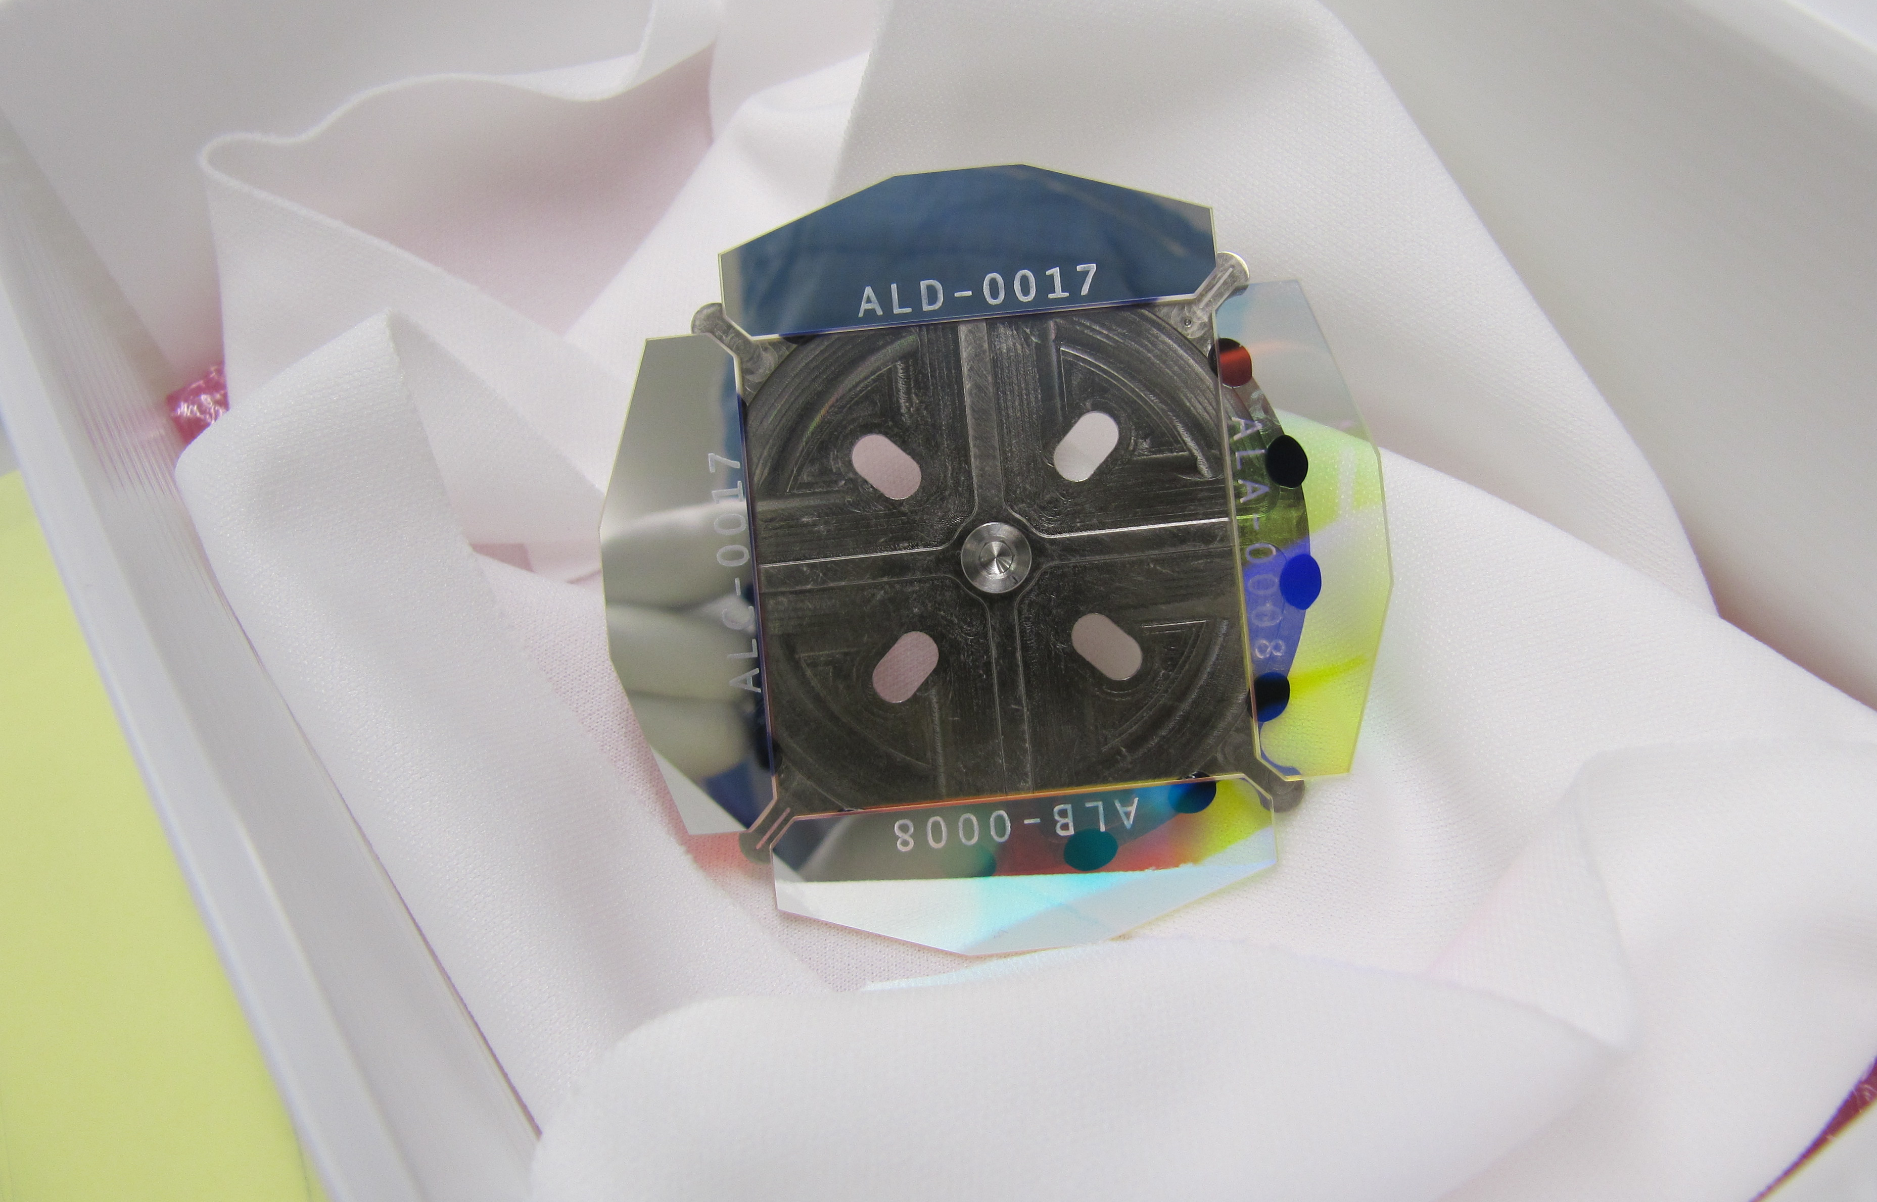
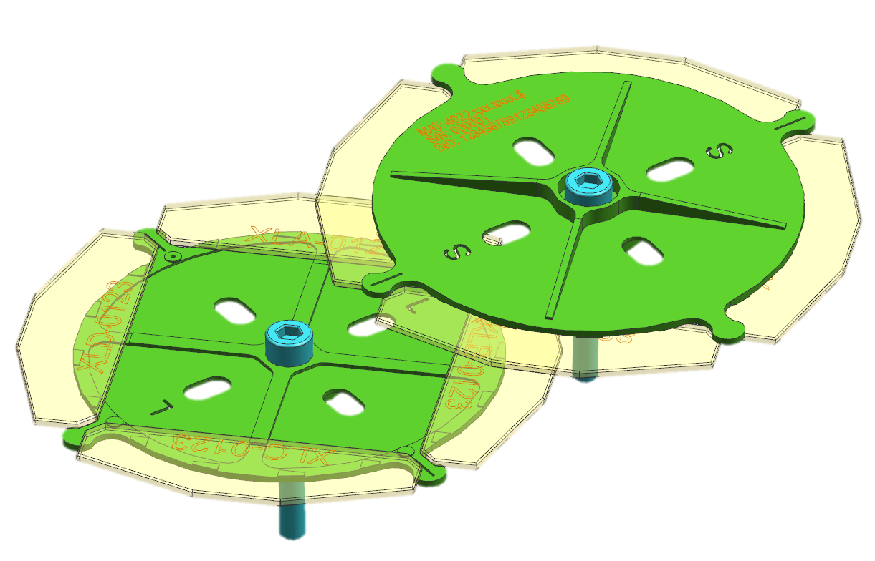
YS SE CL SHORT/LONG WAVE WHEEL ASSY
Inertia driven design to meet timing spec’s
Notes:
In order to switch fast we cut the filters in smaller pieces and glue them on a wheel. The challenge was balancing between low inertia and long filters. As low inertia has impact on timing and long filters on steepness of the filters, as there are then less nm in optical spot.

Slide 11
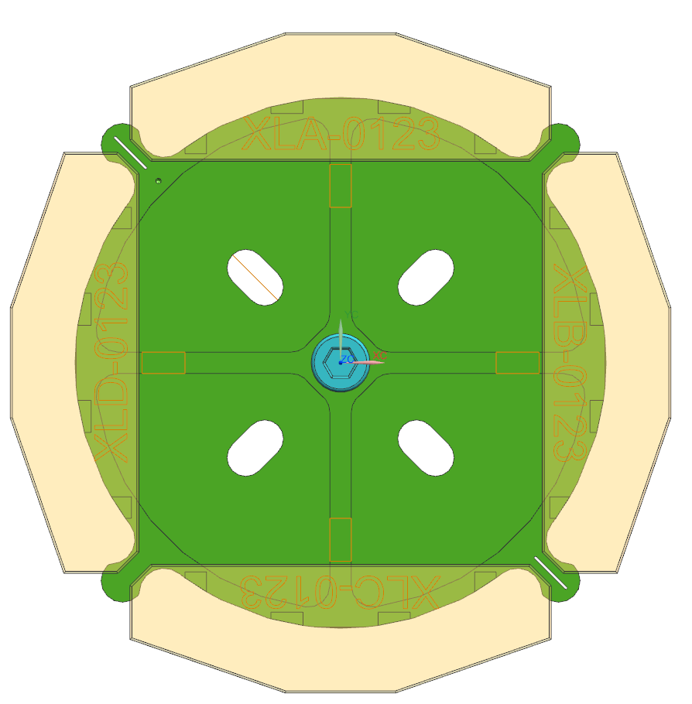
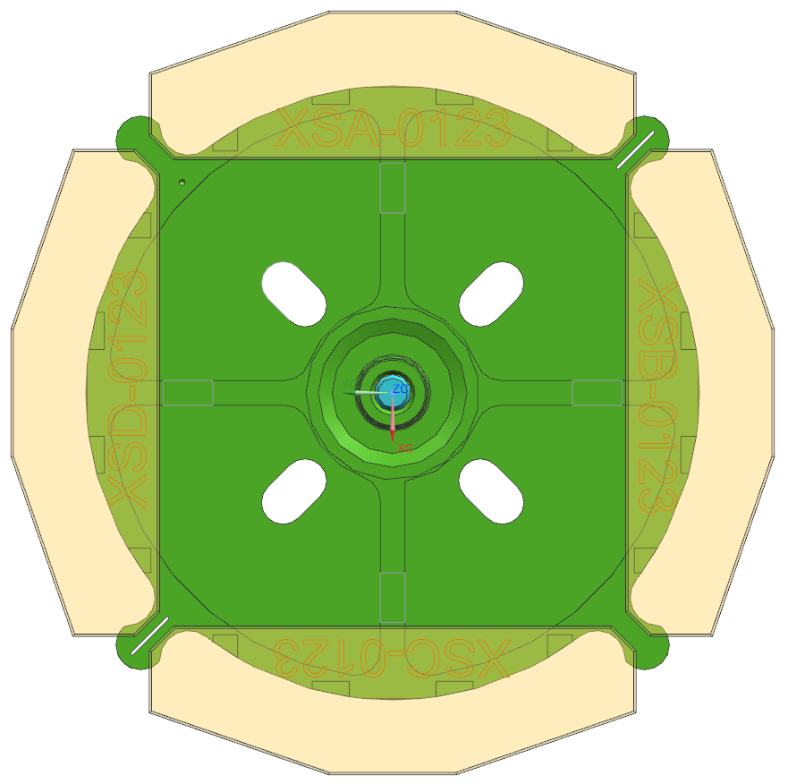
Nominal wavelength positions on filter wheel
With geometrical tolerances
LWP
SWP
2mm
2mm
410nm
410nm
≅531nm
≅531nm
5mm
5mm
895nm
895nm
652.5nm
652.5nm
652.5nm
652.5nm
5mm
5mm
≅774nm
≅774nm
2mm
2mm
652.5nm
652.5nm

Slide 12
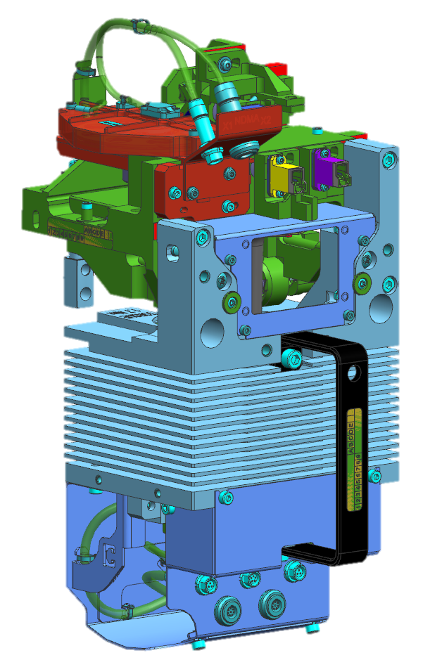
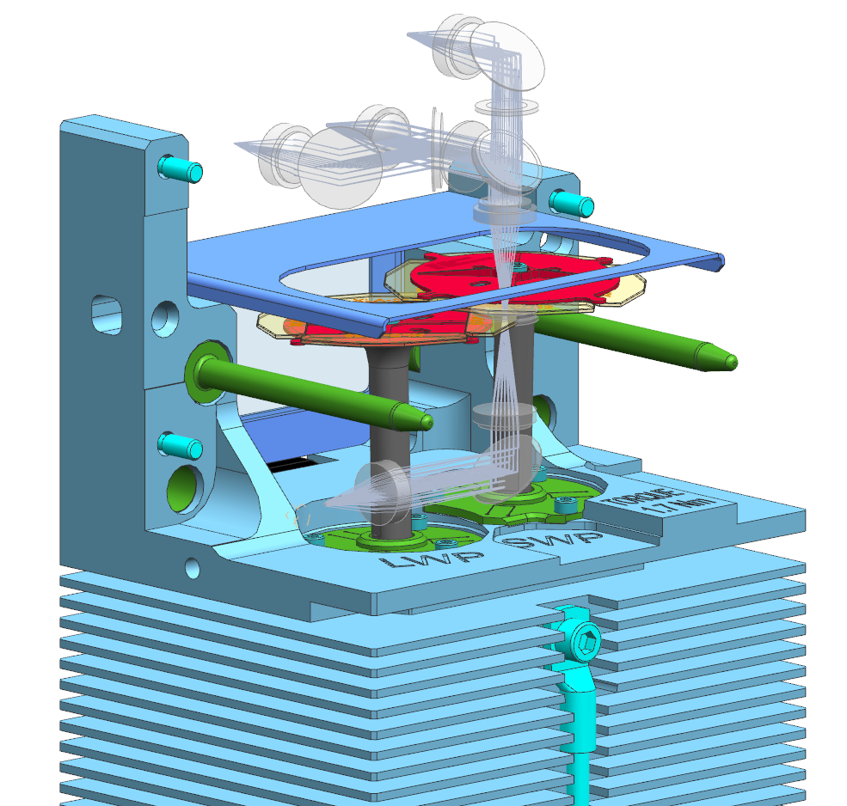
YS SE CL XWP MOTOR ASSY
Motor layout
Notes:
Switching from one wavelength to another < 45ms. (180°)
Motors placed next to each other and rotate in opposite directions to compensate disturbance torques. (0.25Nm)
Motor frame air-cooled
Closest position of the filters wheels is 0.5mm

Slide 13
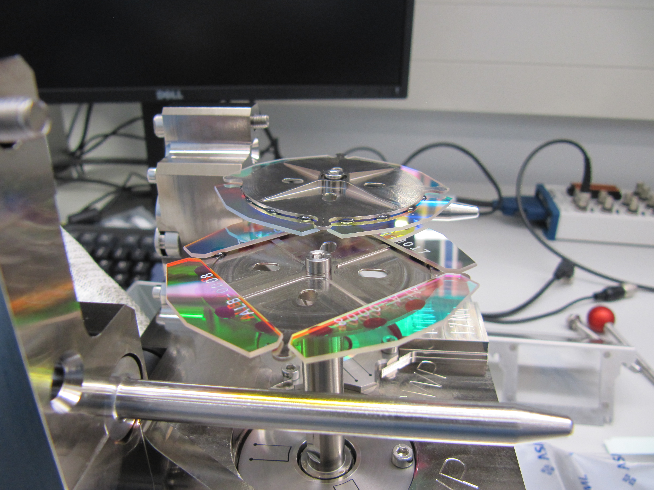
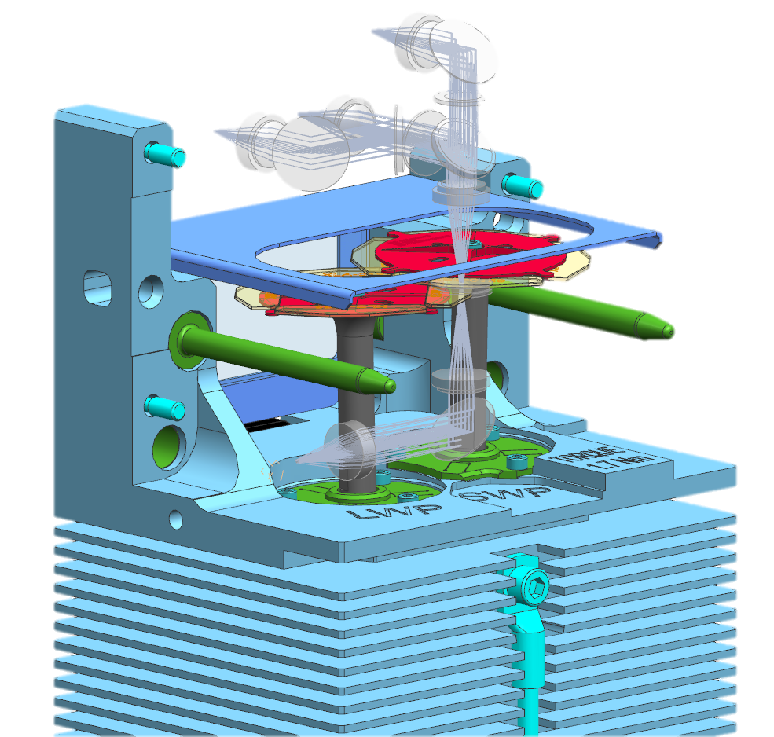
YS SE CL XWP MOTOR ASSY
First filter wheels mounted on motor assy

Slide 14
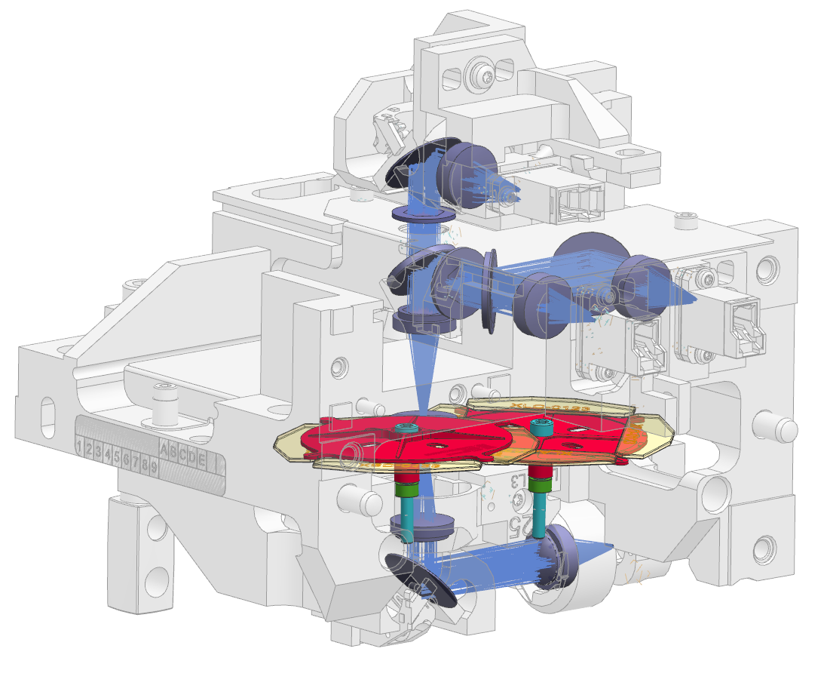
YS SE CL OPTICS ASSY
Optical layout around moving filter wheels
Notes:
12 optical components, only one adjusted in XY. Mirrors and BS positioned on pads with springs. Lenses glued in lens cells and placed on locating pins.
All 4 fiber connectors adjusted as well.

Slide 15
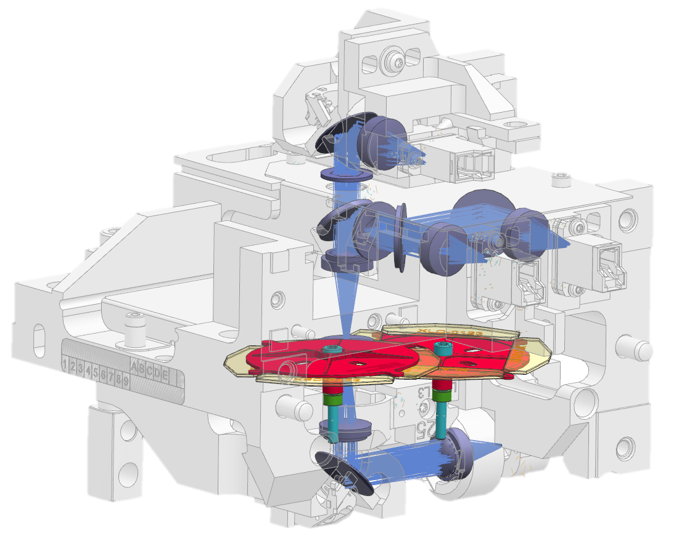
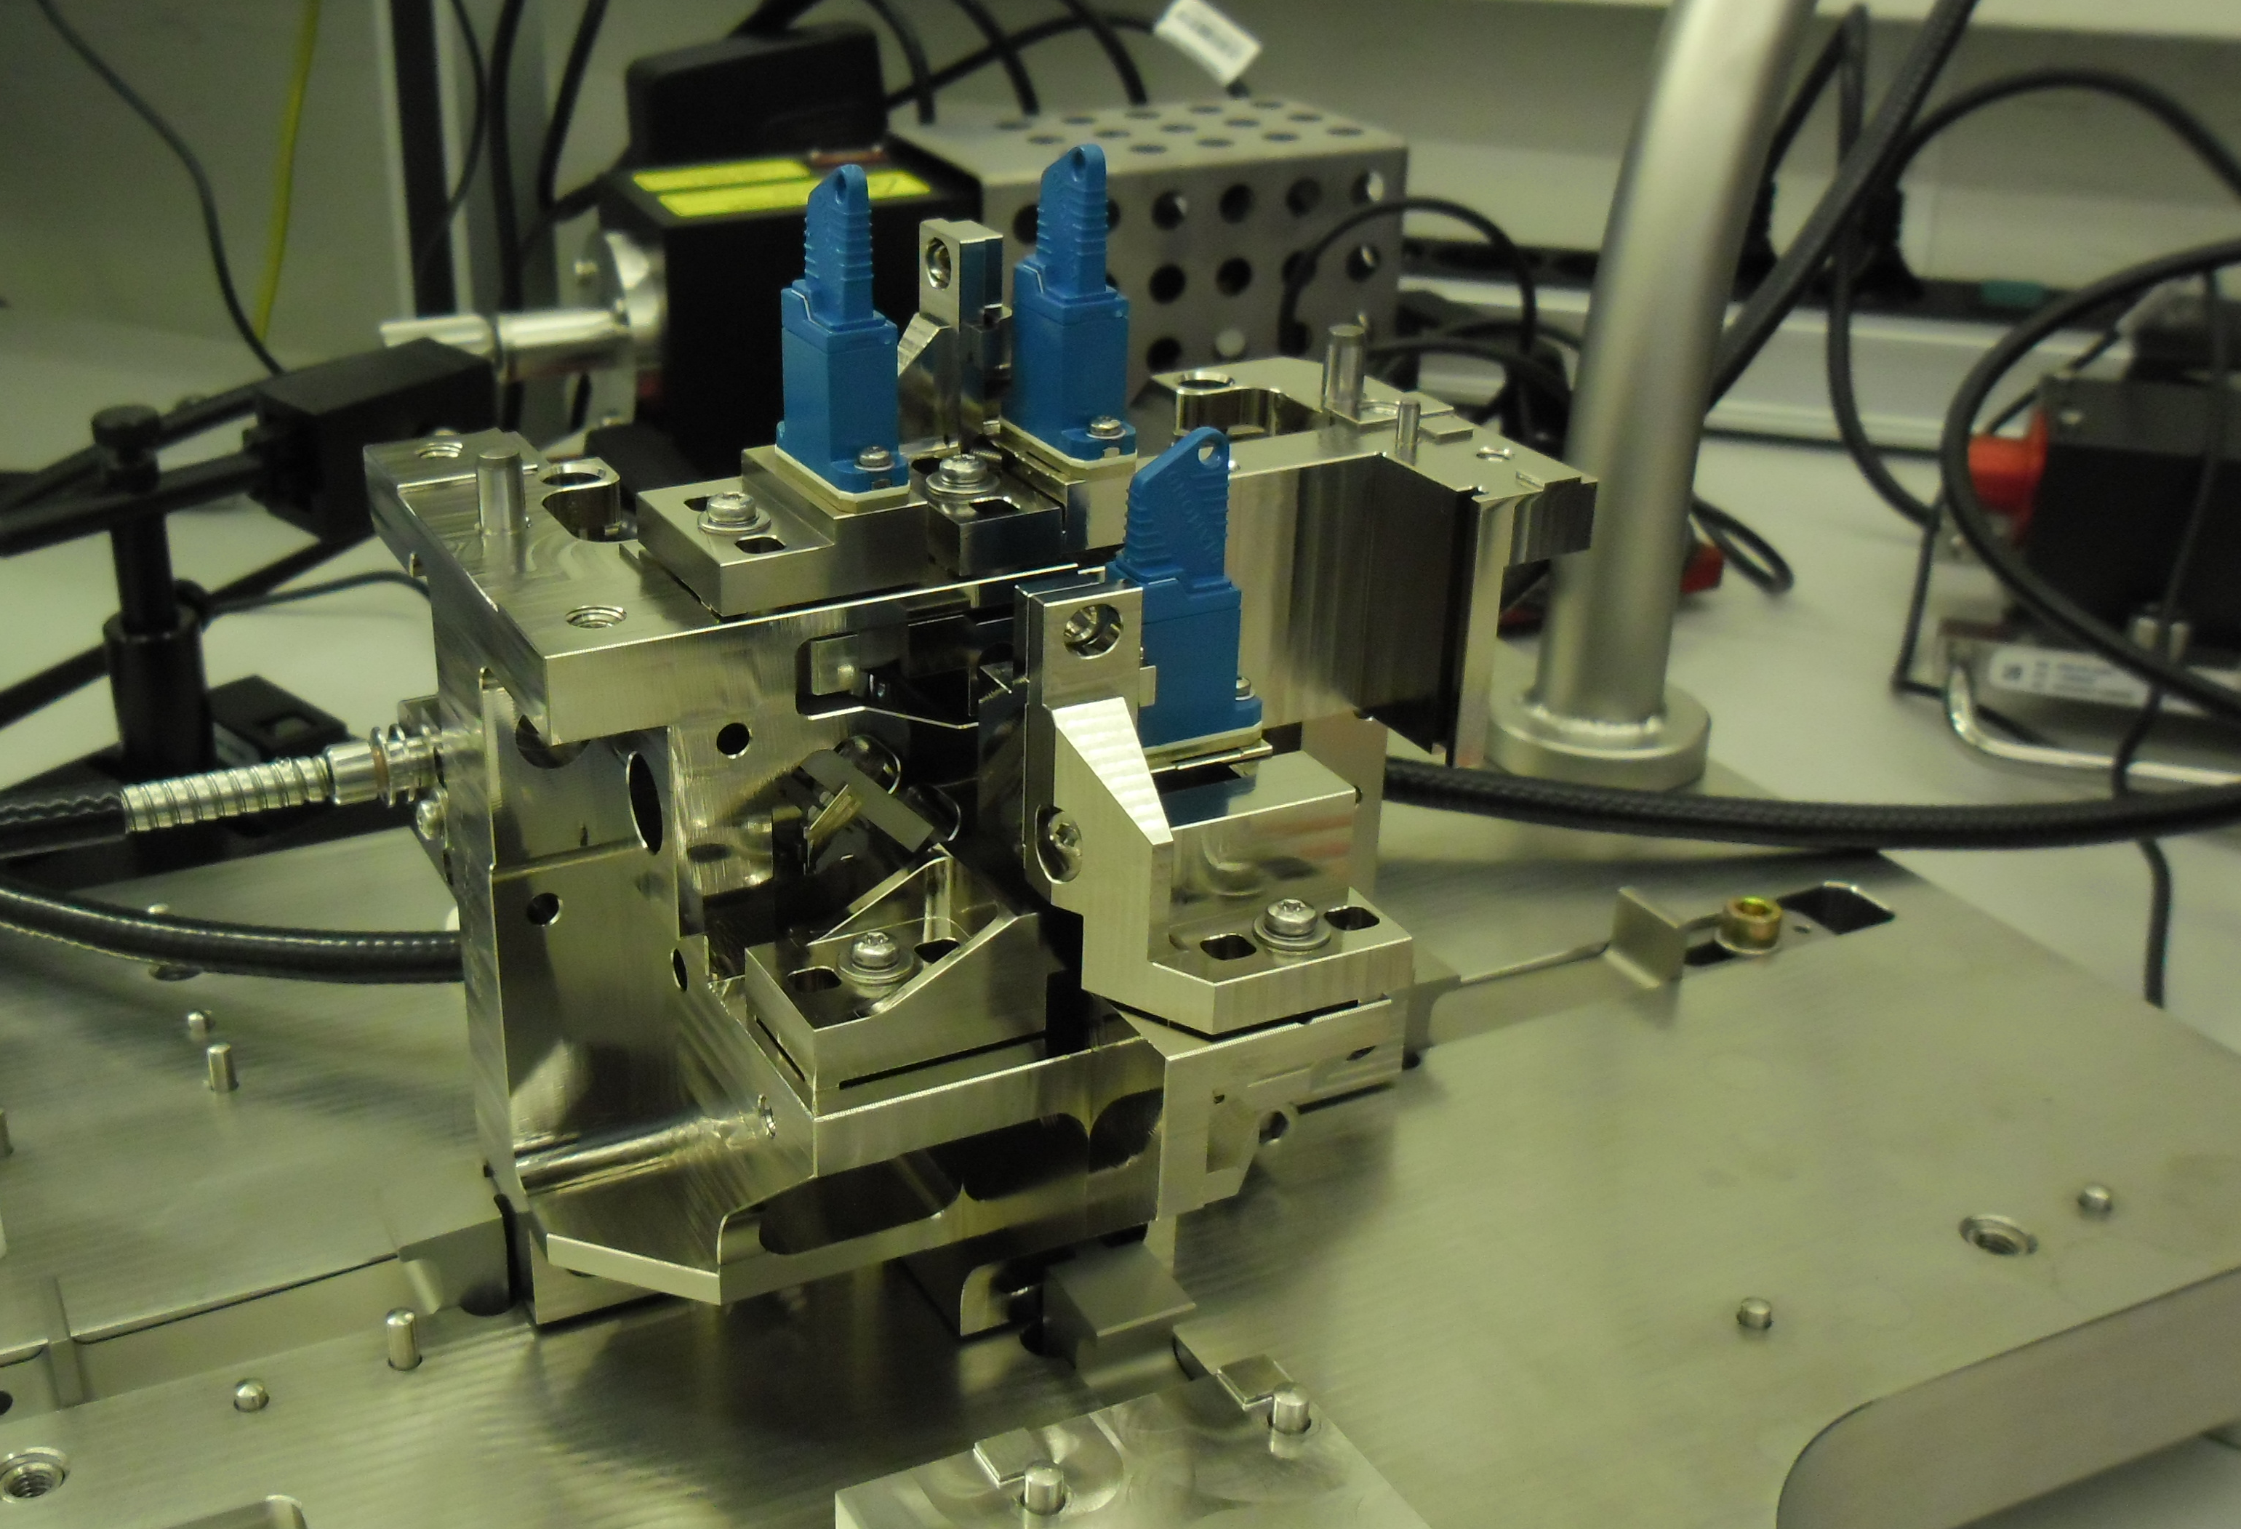
YS SE CL OPTICS ASSY
Fully assembled on main tool

Slide 16
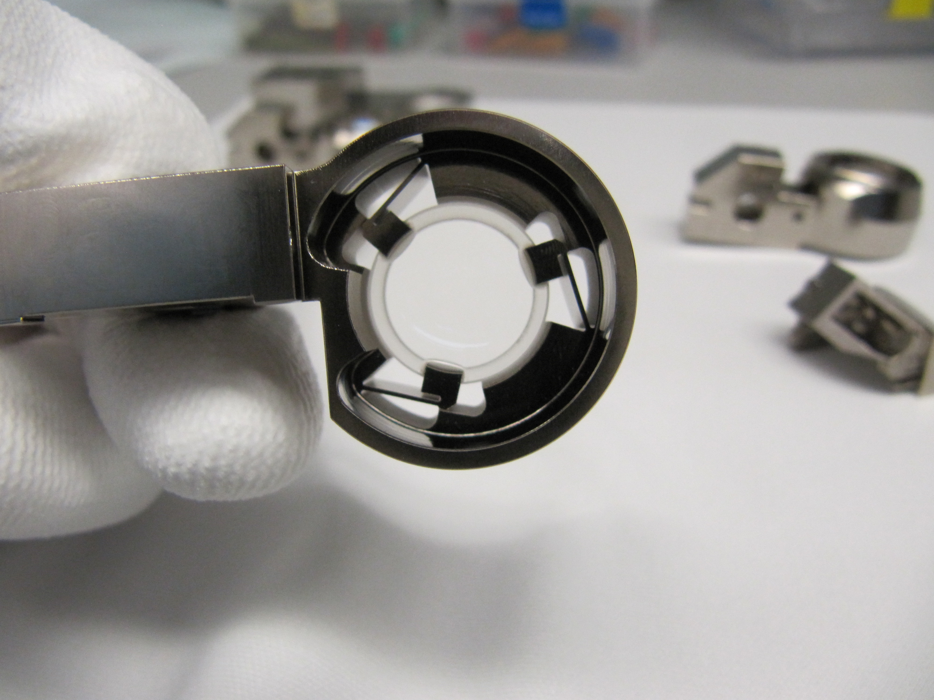
YS SE CL OPTICS ASSY
Lens cell with leaf springs for thermal shocks during transport

Slide 17
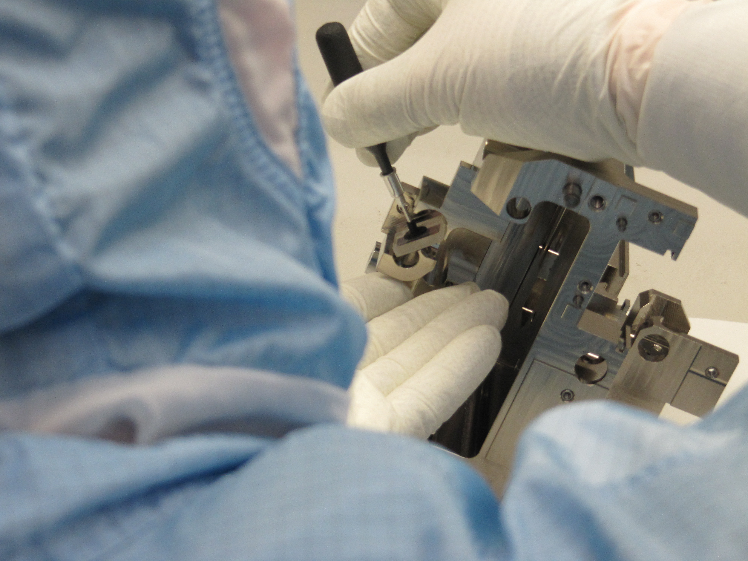
YS SE CL OPTICS ASSY
Placing of first mirror

Slide 18
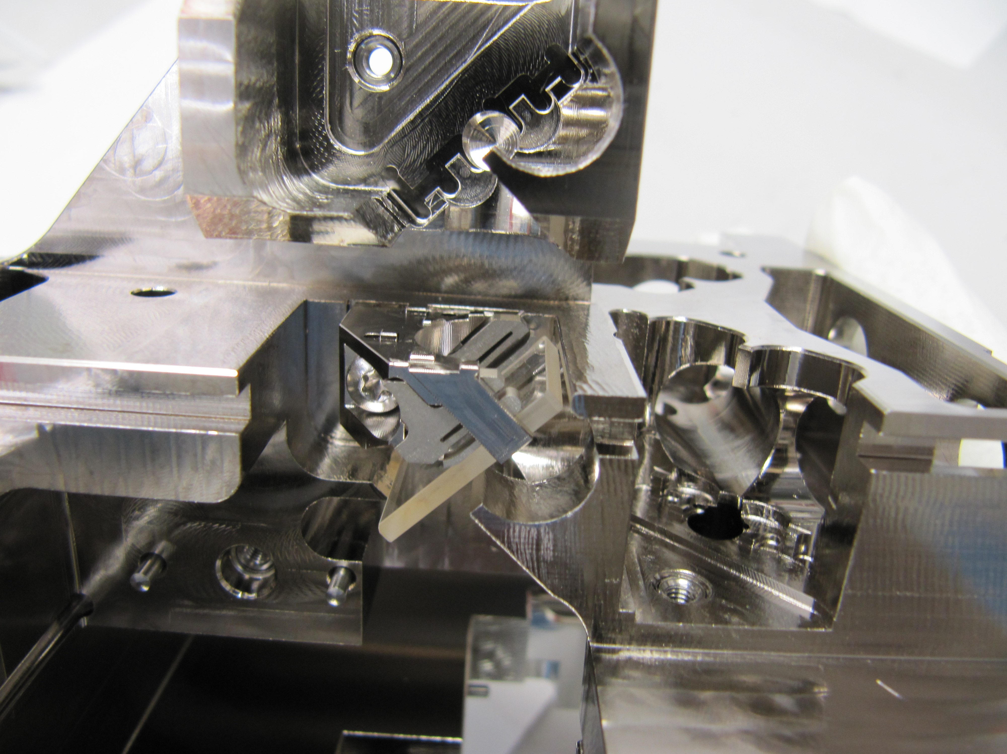
YS SE CL OPTICS ASSY
Springs holding mirrors and beam splitters on pads

Slide 19
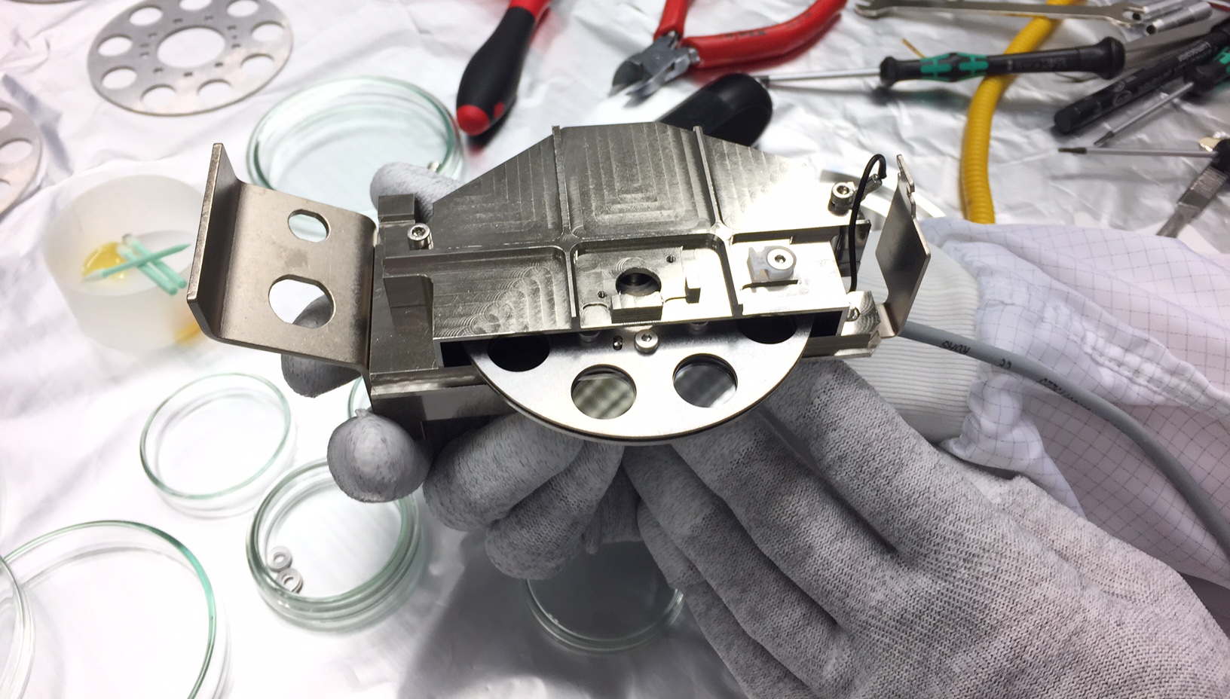
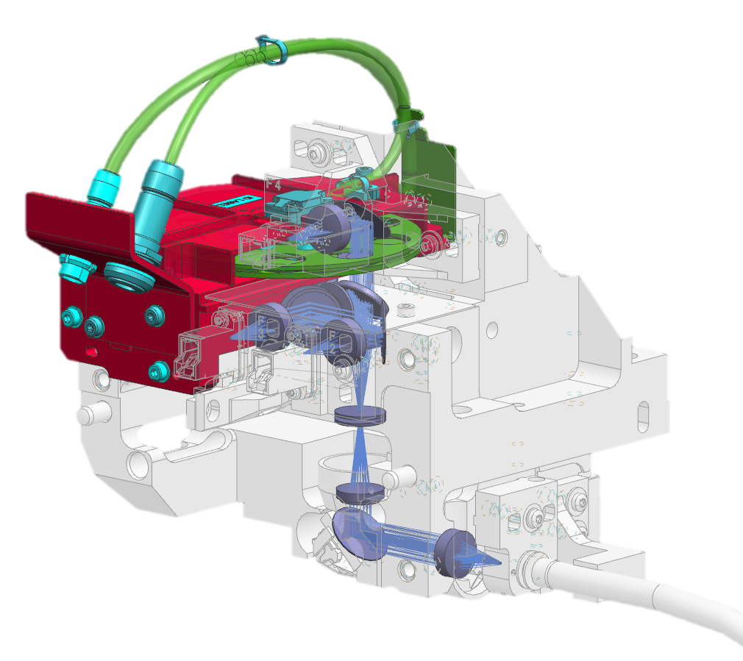
YS SE CL ND FLTR-MTR ASSY
Attenuation of the light

Slide 20
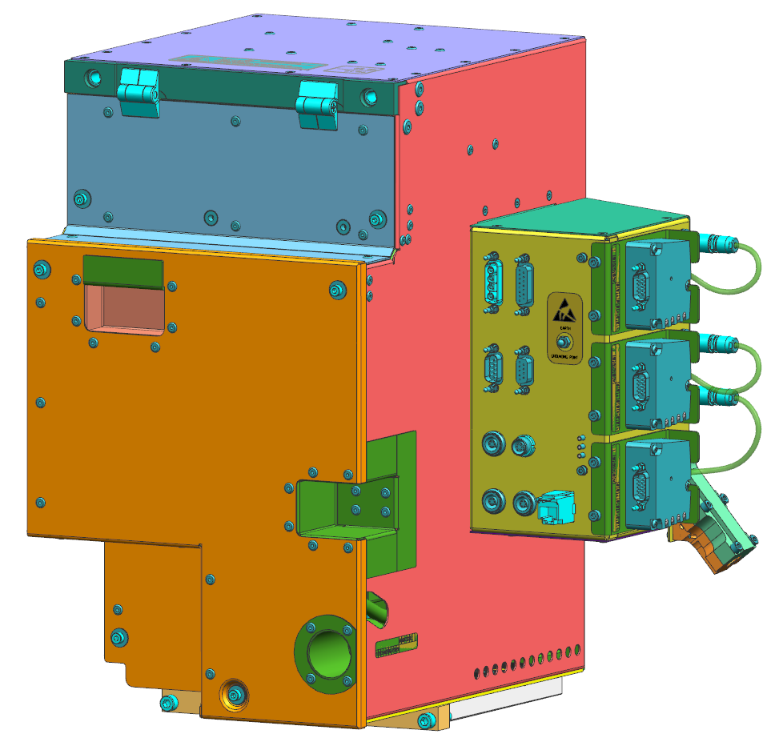
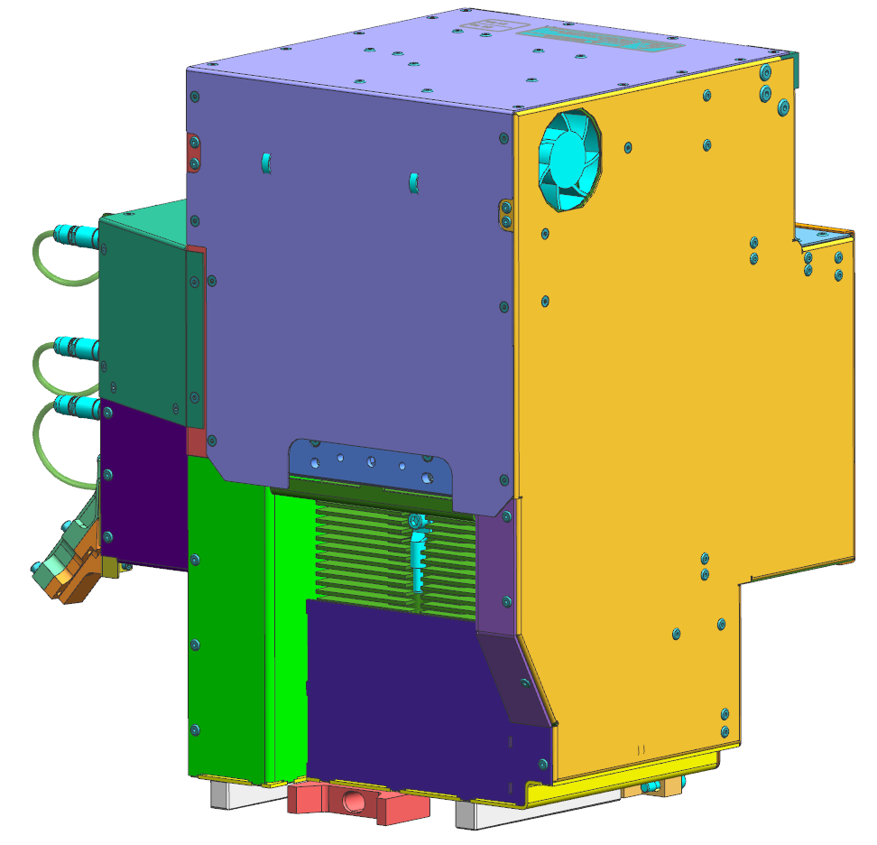
YS SE CL HOUSING ASSY

Slide 21
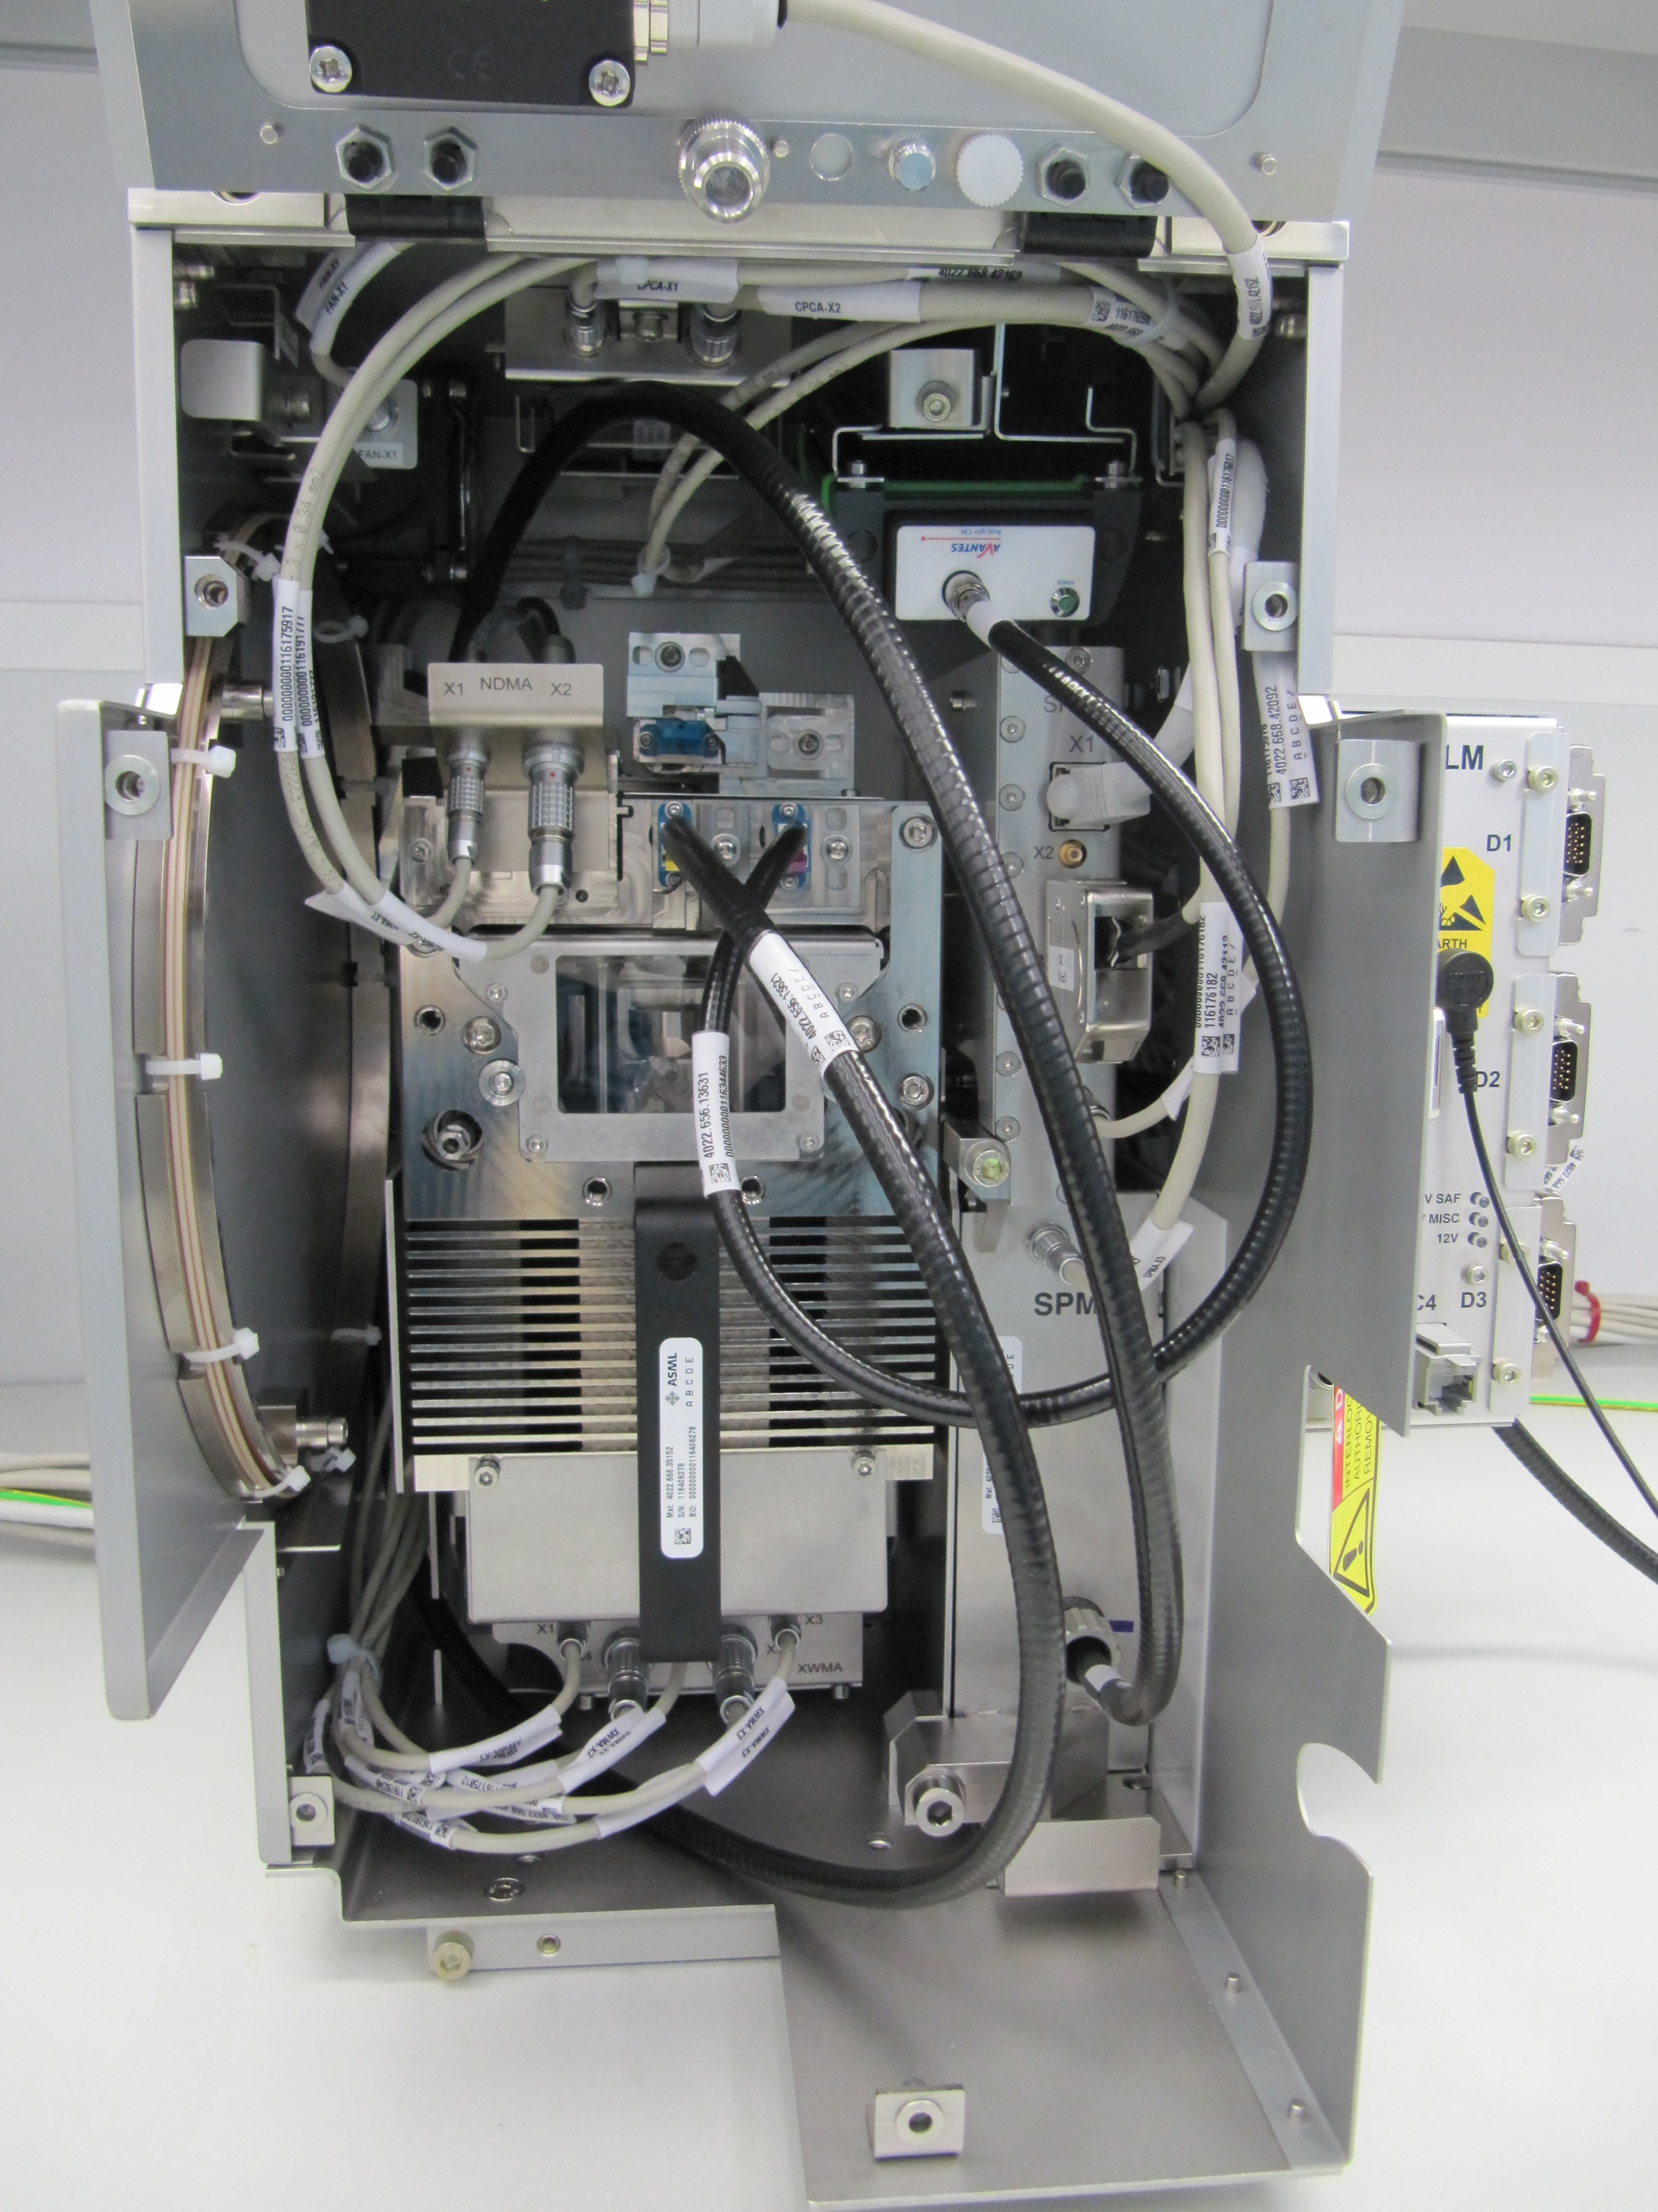
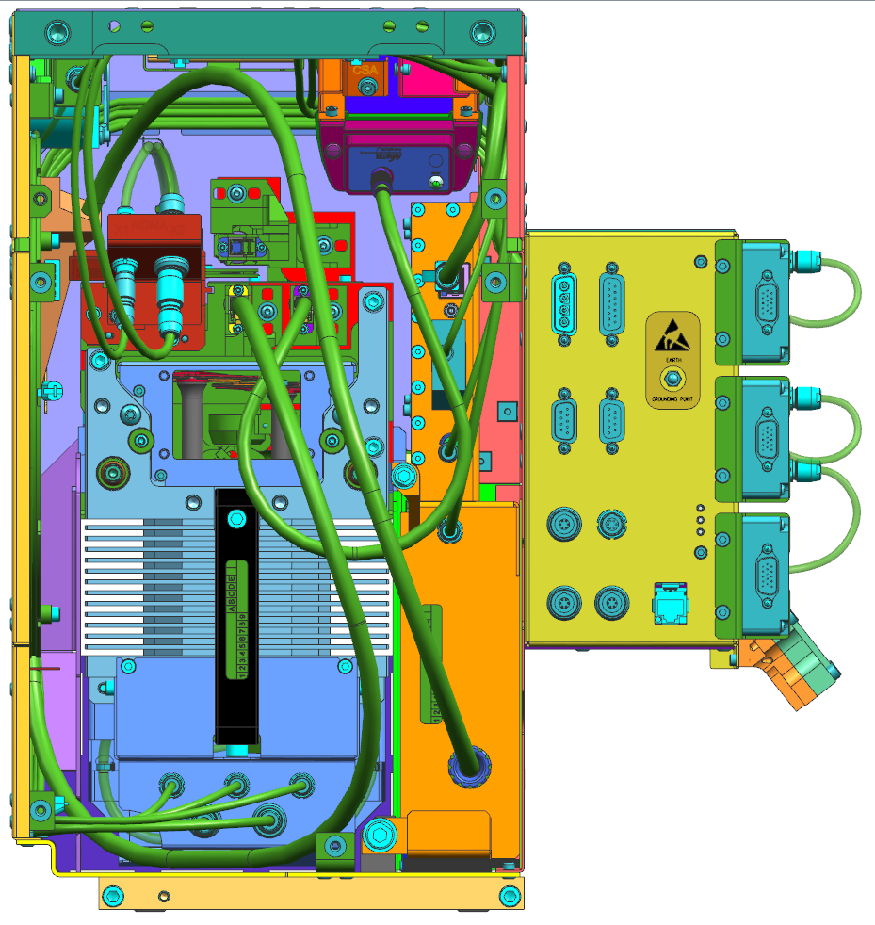
YS SE CL MODULE
Fully assembled module

Slide 22
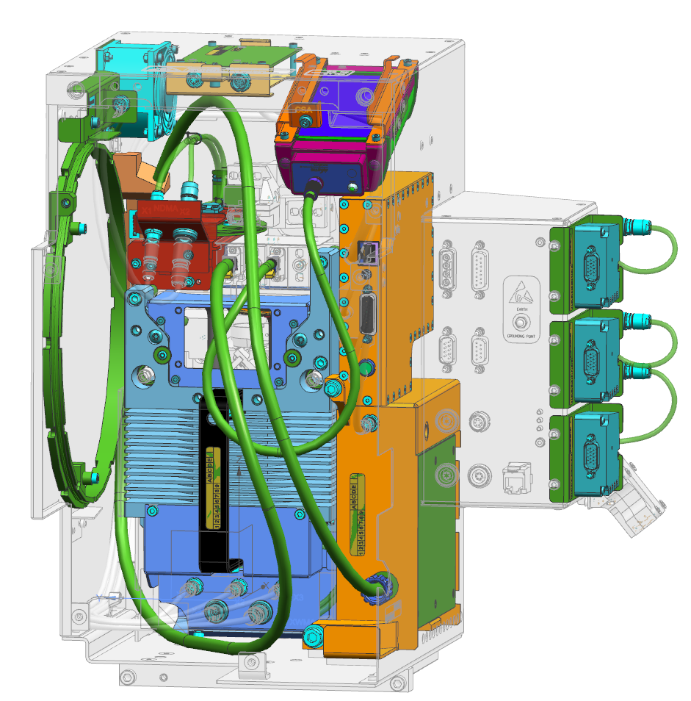
Spare parts accessibility
All spare parts accessible from the front
Active PCA
Cooling fan
Calibration source
Attenuator (5 ND filters)
Interpolators
Linear variable filters
Internal fibers
Motor block
Spectro meter

Slide 23
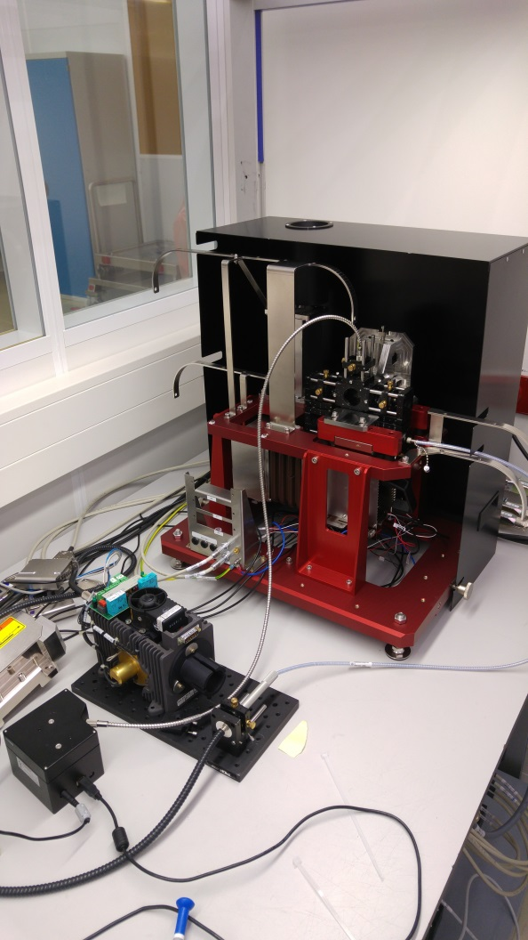
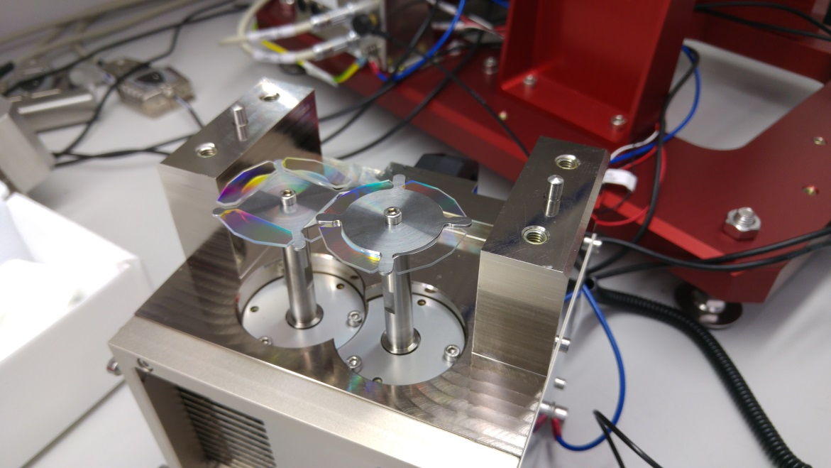
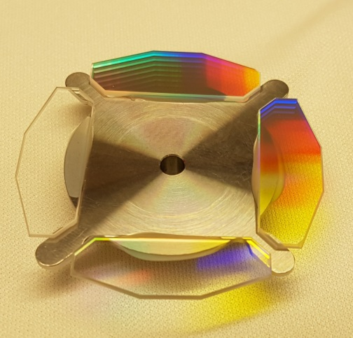
FUMO MTD and optics

Slide 24
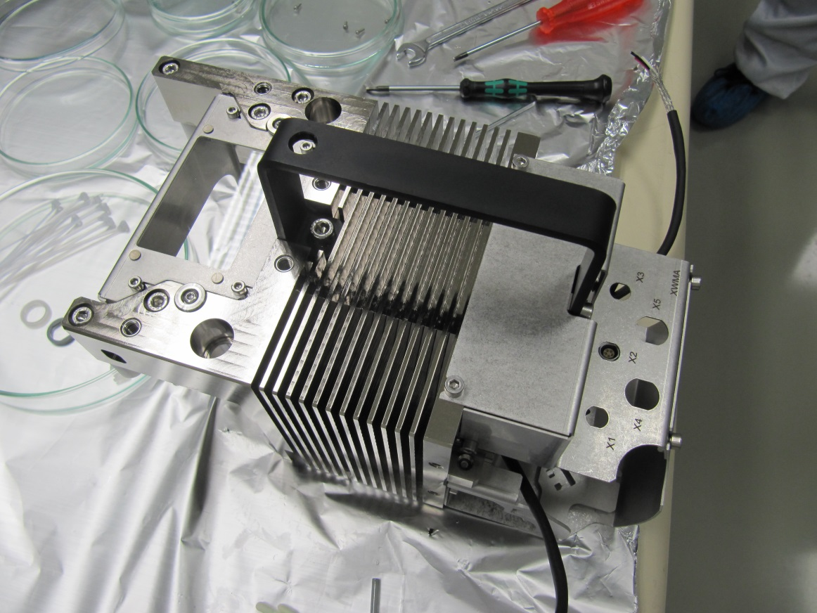
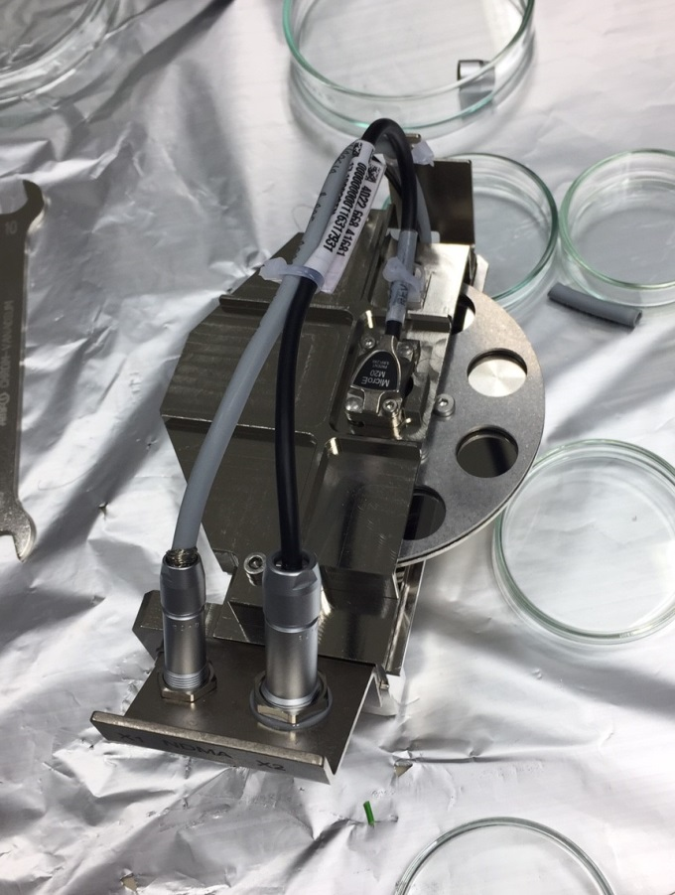
Assembled motor blocks

Slide 25


Housing fittest and optical frame 3D measuring

Slide 26
Separate submodules NX models

Slide 27


Slide 28


Slide 29


Slide 30


Slide 31

4022.666.35152 YS SE XWP MOTOR ASSY

Slide 32

4022.666.35201 YS SE OPTICS ASSY

Slide 33

4022.666.35451 YS SE CL ND FLTR-MTR ASSY

Slide 34

4022.666.35501 YS SE CL HOUSING ASSY

Slide 35

4022.656.13051 YS SE LONG WAVE WHEEL ASSY 4022.656.13061 YS SE SHORT WAVE WHEEL ASSY

Slide 36

4022.668.41861 YS CLM EXHAUST FAN ASSY

Slide 37

4022.668.41901 YS CLM INTERPOLATOR ASSY

Slide 38

4022.668.41831 YS CLM CALIBRATION ASSY

Slide 39

4022.668.41881 YS CLM CONVERTER ASSY

Slide 40

4022.666.35401 YS SE CL SPECTROMETER ASSY

Slide 41

4022.666.58971 YS SE CL FIBER IN ASSY

Slide 43

Airflow cooling

